Slide 1
Computer graphics III – Bidirectional path tracing
Jaroslav Křivánek, MFF UK
Jaroslav.Krivanek@mff.cuni.cz

Slide 2
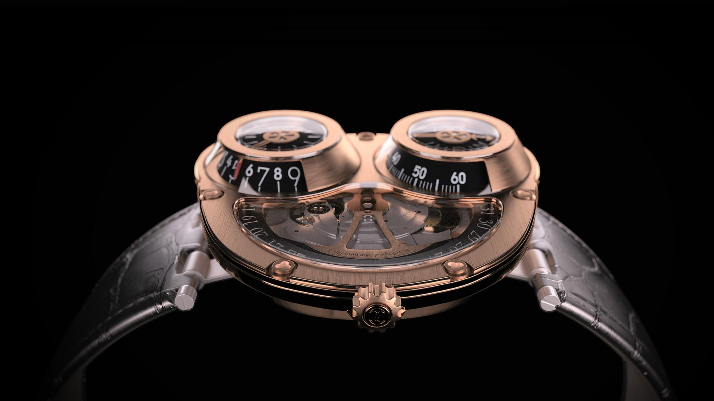

Jerome White

Slide 3
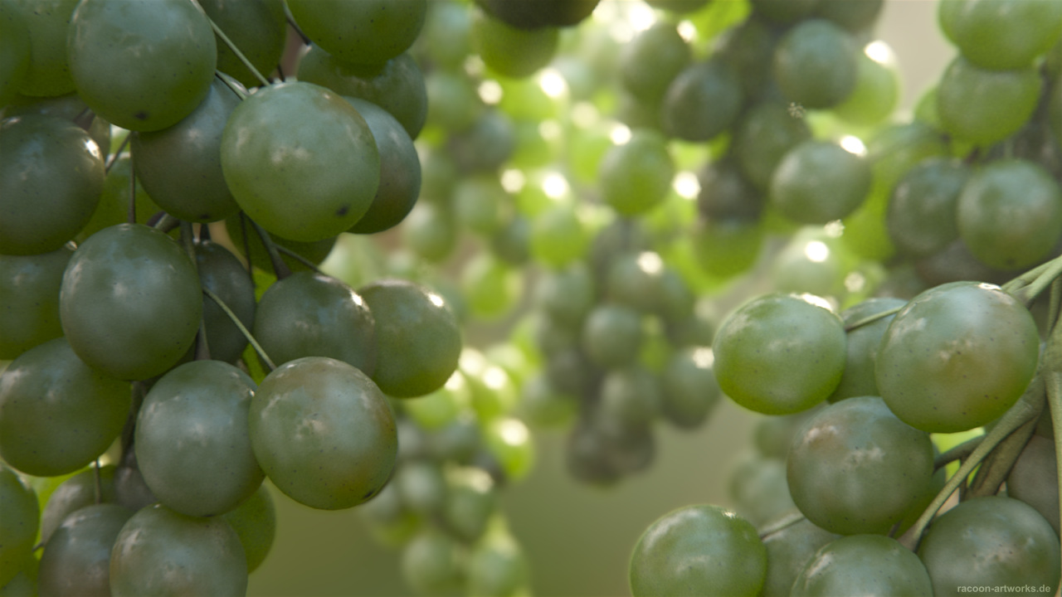
Martin Geupel (DeadClown)

Slide 4
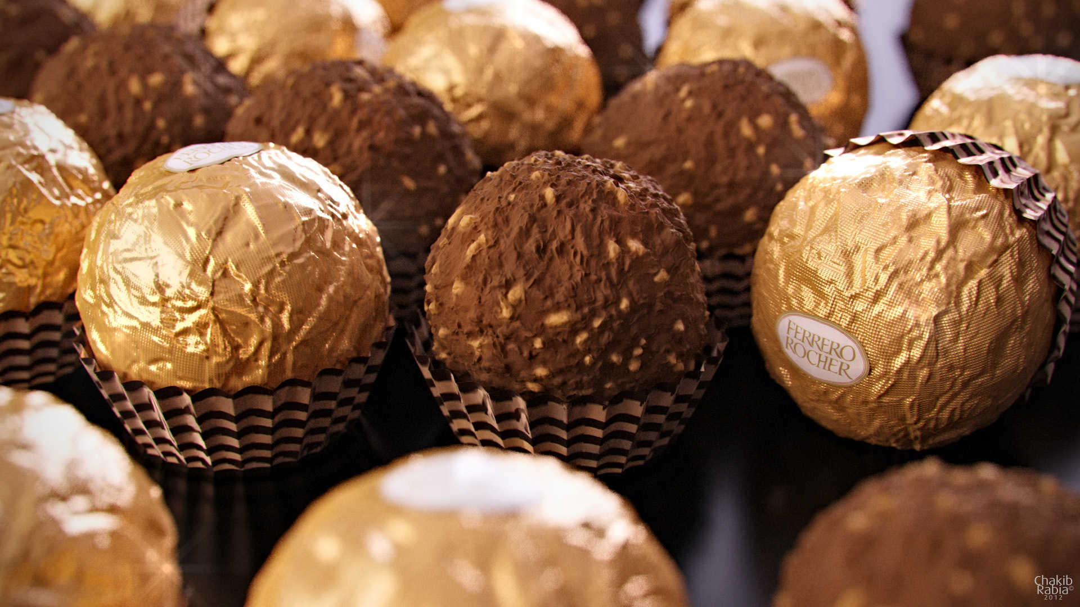
Chakib Rabia

Slide 5
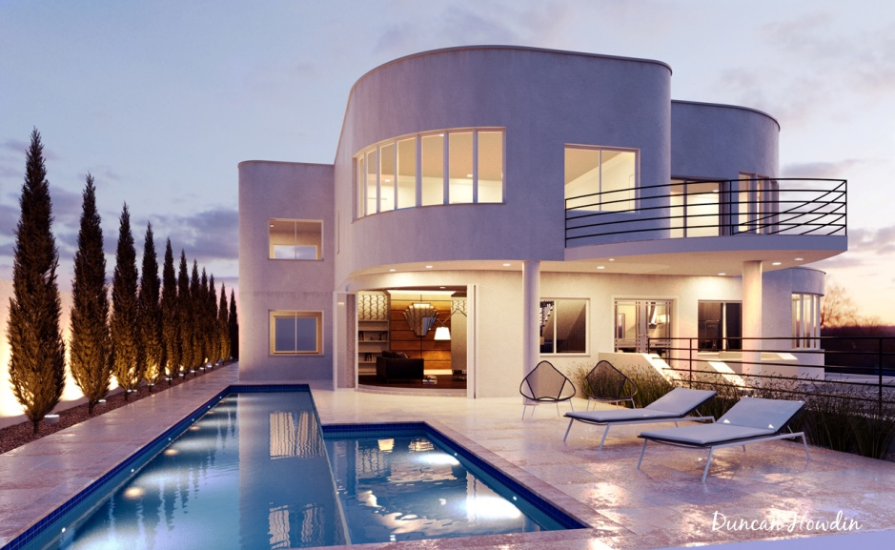
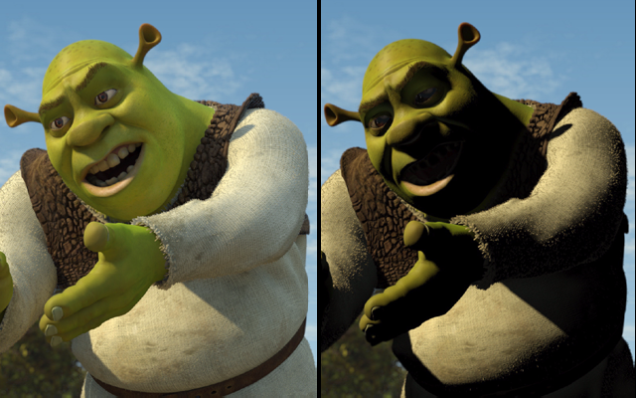

Light transport – Global illumination
Archviz
Movies
© Duncan Howdin
Image courtesy of Columbia Pictures. © 2006 Columbia Pictures Industries, Inc.
Notes:
Light transport simulation is an essential component of rendering realistic images with global illumination.
It’s been a standard tool in architectural and product visualization for many years now, with maxwell renderer being one of the first commercially available solutions based on unbiased Monte Carlo simulation.
Its use in movies picked up later due to technical difficulties (large scenes, tighter rendering time budget).

Slide 6

Light transport – Global illumination
More information
“The State of Rendering”
Notes:
A fairly detailed account on the state of rendering in the VFX community is given in a recent fxguide article “The State of Rendering”.
They also mention that the Vertex Connection and Merging algorithm will be used in PRMan 19 (http://cgg.mff.cuni.cz/~jaroslav/papers/2012-vcm/index.htm).

Slide 7
Measurement equation

Slide 8
Measurement equation
Rendering equation enables evaluating radiance at isolated points in the scene
But in fact, we are interested in average radiance over a pixel: an integral, again?!
Yes, it’s called the Measurement equation

Slide 9
Measurement equation
Response of a virtual linear sensor to light (most commonly the pixel color).
Relative response (weight).
Each sensor (pixel) has a different W_{e} function.
Integrate over the entire scene surface.
(We assume that the virtual sensor is a part of the scene. The response is non-zero only on the sensor area because W_{e} is zero elsewhere.)
Notes:
Nakreslit model senzoru (pixel)

Slide 10
Example measurement: Radiant flux over a region formulated as a ME
Given a region S in ray space (a subset of the Cartesian product of the scene surfaces and directions)
For W_{e} defined as the result of the measurement equation is the radiant flux Φ(S).

Slide 11
Measurement equation as a scalar product of functions
Let us define a scalar product of function f and g as:
The Measurement equation can now be written as

Slide 12
Transport of radiance and visual importance
L (radiance)
W (importance)

Slide 13
Visual importance
W_{e} describes how important is the incident radiance to the sensor response
One step into the scene: Incident radiance on the sensor = outgoing radiance from other scene points
And we can go on to 2, 3, … steps into the scene…
As a result, W_{e} can be interpreted as an (imaginary) transport quantity emitted from the sensor (similarly to how radiance L_{e} is emitted from light sources)
In this interpretation, we call W_{e} the emitted importance function

Slide 14
Transport of visual importance
The importance function is transported by the similar rules to radiance and settles down on an equilibrium (steady state) given by the equilibrium visual importance function W:
As in the rendering equation except that the BRDF arguments are exchanged (No difference for reflection because the BRDF is symmetrical, but it makes difference for transmission, which is in general not symmetrical.)

Slide 15
Duality of importance and radiance
Emitted importance
Equilibrium incident radiance
Equilibrium incident importance
Emitted radiance

Slide 16
Duality of importance and radiance – proof
r stands for (x,ω)

Slide 17
Duality of importance and radiance
In a given scene, there is only one emitted and equilibrium radiance function
But each pixel has its own emitted and equilibrium visual importance function

Slide 18
Duality in practice: Light tracing
Path tracing recursively solves the rendering equation
Similarly, light tracing recursively solves the importance transport equation
Light paths start at the light sources and are traced into the scene using exactly the same rules as photons in photon mapping
They may either hit the sensor by chance (for a finite aperture camera) or we can explicitly connect vertices to the sensor (as in explicit light source sampling in PT)

Slide 19
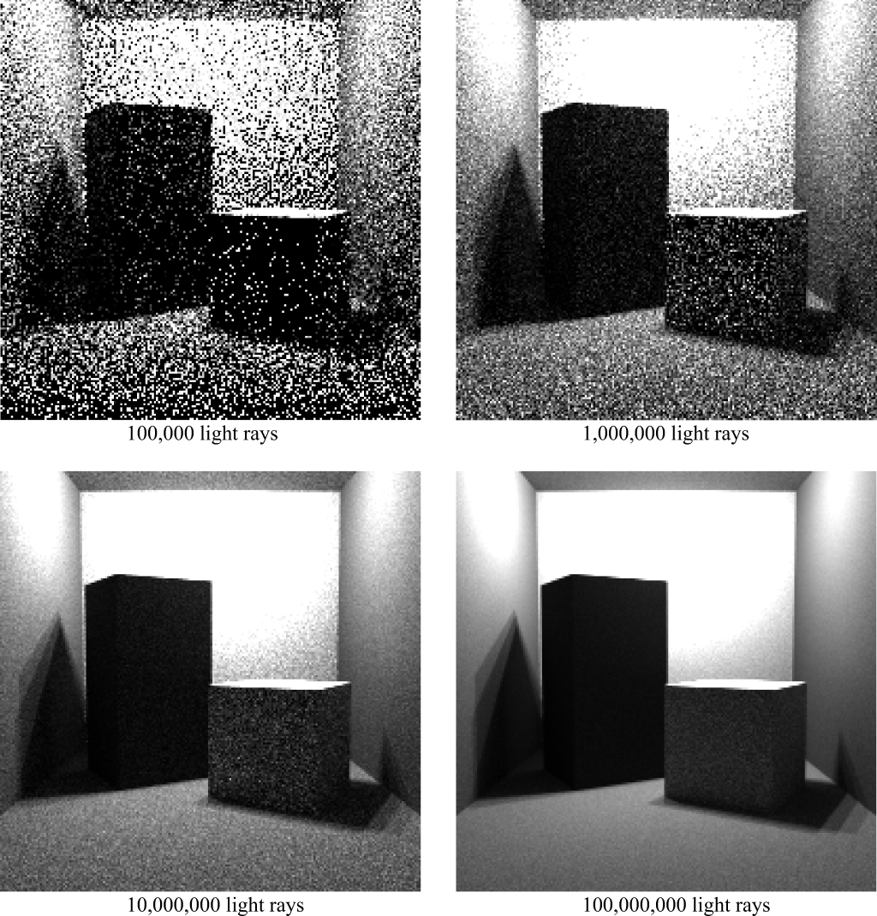
Light tracing
Image: Dutre et al. Advanced Global Illumination

Slide 20
Light tracing in practice
Generally less efficient than PT
But it certain case, it may be much better. One example are caustics.
Light tracing and path tracing are the basis of bidirectional methods, such as
Bidirectional path tracing, BPT
Photon mapping, etc.

Slide 21
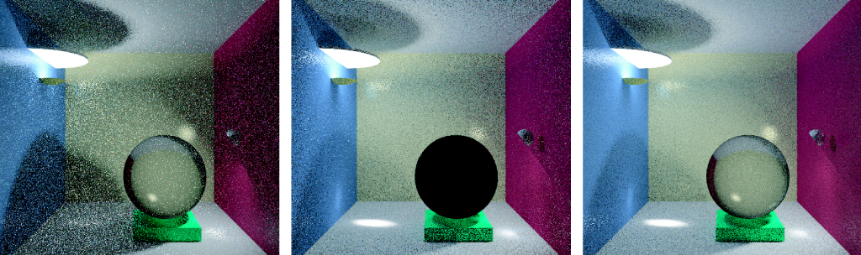
Comparison
© F. Suykens
Path tracing
Light tracing
Bidirectional path tracing
Q: Why is the glass sphere entirely black?

Slide 22
Advanced light transport simulation methods

Slide 23

Main issue in light transport simulation
Robustness
None of the existing algorithms works for all scenes
Robust estimation
“An estimation technique which is insensitive to small departures from the idealized assumptions which have been used to optimize the algorithm.”
Notes:
A number of light transport algorithms exist, such as path tracing (PT), bidirectional path tracing (BPT), photon mapping (PM), or Metropolis light transport (MLT); and there are many variants of these algorithms.
However, the single most pressing issue with all of these solutions is that none of them really works for all practical scenes.
In other words, these solutions are not robust enough.
Robustness of a statistical estimator (such as our rendering process) is defined by Wolframs MathWorld as follows: “An estimation technique which is insensitive to small departures from the idealized assumptions which have been used to optimize the algorithm.”
In rendering, it means that a robust algorithm should be reasonably efficient for any input scene. The current light transport algorithms unfortunately do not exhibit this desirable feature.

Slide 24
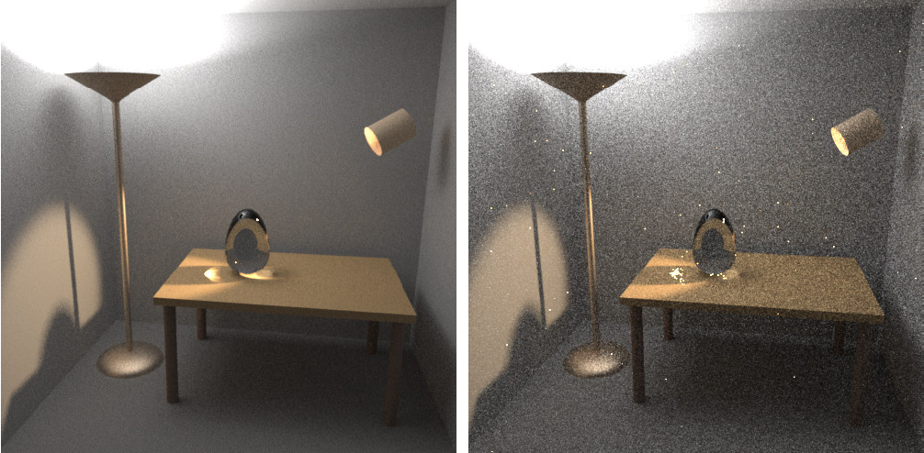
Bidirectional path tracing (BPT) vs. (unidirectional) path tracing (PT)
Image: Eric Veach
BPT, 25 path per pixel
PT, 56 path per pixel

Slide 25
Path integral formulation of light transport
Light transport expressed as an integral over the space o light transport paths

Slide 26

Light transport
Geometric optics
emit
travel
reflect
scatter
Notes:
In the real world, light sources emit light particles, which travel in space, reflect at objects or scatter in volumetric media (potentially multiple times) until they are absorbed.
On their way, they might hit the sensor of the camera which will record the light contribution.

Slide 27
Light transport
Geometric optics
emit
travel
reflect
scatter
light transport path
Notes:
The light particles travel along trajectories that we call “light transport paths”.
In an environment consisting of surfaces and media with constant index of refraction, these paths are polylines whose vertices correspond to reflection at surfaces or scattering events in media, and the straight edges correspond to light travelling the in the space.

Slide 28
Light transport
Camera response
all paths hitting the sensor
Notes:
The final response of the camera is due to all the light particles – travelling over all possible paths – that hit the camera sensor during the shutter open period.

Slide 29
Path integral formulation
all paths
camera resp.
(j-th pixel value)
measurement contribution function
[Veach and Guibas 1995]
[Veach 1997]
Notes:
The path integral formulation of light transport is nothing but a mathematical formulation of this simple physical idea.
The camera response (which, in image synthesis will be the value of a pixel) is written as an integral over all light transport paths of all lengths in the scene.
The integrand of this integral is the so called “measurement contribution function”.
The measurement contribution function of a given path encompasses the “amount” of light emitted along the path, the light carrying capacity of the path, and the sensitivity of the sensor to light brought along the path.

Slide 30
Measurement contribution function
emitted
radiance
path
throughput
sensor sensitivity (“emitted importance”)
Notes:
Let us now look at a more formal definition of the measurement contribution for a light path.
As I already mentioned, a light transport path is a polyline with vertices corresponding to light reflection on surfaces or scattering in media.
We write the path (of length k) simply as a sequence of vertices, in the order of light flow. So the first vertex, x₀, corresponds to light emission at the light source and the last vertex, x_{k}, to light measurement at the sensor.
The measurement contribution function f(x) for a path x is defined as the emitted radiance L_{e} at the first vertex, times the sensitivity (or “emitted importance”) W_{e} at the last vertex, times the path throughput T(x).
The throughput is a product of the geometry term G and volume transmittance T_{r} for each path edge, and reflection/scattering terms for each interior path vertex.
The geometry term measures the differential throughput along an edge and is essentially a point-to-point form factor.
The transmittance T_{r} tells us how much light is not attenuated due to medium absorption and out-scattering.

Slide 31
Geometry term
Notes:
The geometry term, or point-to-point form factor, of a path edge expresses the throughput of the edge due to geometry configuration of the scene, and is given by the product of the inverse-squared-distance, cosine factor at the vertices and the visibility term.

Slide 32
Path integral formulation
all paths
camera resp.
(j-th pixel value)
measurement contribution function
?
✓
Notes:
Back to the path integral…
We now know the meaning of the integrand – the path contribution function – but the integration domain of “all path” deserves more clarification.

Slide 33
Path integral formulation
all path lengths
all possible
vertex positions
Notes:
The path integral actually hides an infinite sum over all possible path lengths.
Each summand of this sum is a multiple integral, where we integrate the path contribution over all possible positions of the path vertices.
So each of the integrals is taken over the Cartesian product of the surface of the scene with itself, taken k+1 times (=number of vertices for a length-k path.)
The integration measure is the product of the measures for each vertex: an area measure, i.e. the natural surface area, for vertices on surfaces, and the natural volume measure for vertices in media.

Slide 34
Path integral
pixel value
all paths
contribution function
Notes:
We now have a formula for pixel values that has a form of a simple (though infinite-dimensional) integral.
Rendering and images is nothing but a numerical evaluation of this integral for all image pixels.

Slide 35
Rendering : Evaluating the path integral
Notes:
So the next section of this presentation well be devoted to numerical evaluation of the path integral.

Slide 36
Path integral
pixel value
all paths
contribution function
Monte Carlo integration
Notes:
We will use Monte Carlo integration for this purpose because that is the most flexible and general numerical integrations scheme.

Slide 37
Monte Carlo integration
General approach to numerical evaluation of integrals
Integral:
f(x)
Monte Carlo estimate of I:
p(x)
0
x₅
x₃
x₁
x₄
x₂
x₆
1
Correct „on average“:
Notes:
Let me briefly review the basic elements of MC integration.
Suppose we are given a real function f(x) and we want to compute the integral Int f(x) dx over some domain (in this example we use the interval [0,1] for simplicity, but the domain can be almost arbitrary.)
The Monte Carlo integration procedure consists in generating a ‘sample’, that is, a random x-value from the integration domain, drawn from some probability distribution with probability density p(x). In the case of the path integral, the x-value is an entire light transport path.
For this sample x_{i}, we evaluate the integrand f(x_{i}), and the probability density p(x_{i}).
The ratio f(x_{i}) / p(x_{i}) is an estimator of the integrand. To make the estimator more accurate (i.e. to reduce its variance) we repeat the procedure for a number of random samples x₁, x₂, …, x_{N} , and average the result as shown in the formula on the slide.
This procedure provides an unbiased estimator of the integrand, which means that “on average”, it produces the correct result i.e. the integral that we want to compute.

Slide 38
MC evaluation of the path integral
Path integral
MC estimator
Sample path from some distribution with PDF
Evaluate the probability density
Evaluate the integrand
?
?
✓
Notes:
Thanks to the formal simplicity of the path integral formulation, applying Monte Carlo integration is really a more-or-less mechanical process.
For each pixel, we need to repeatedly evaluate the estimator shown at the top right of the slide and average the estimates.
This involves the following three steps:
First, we need to draw (or sample, or generate – all are synonyms) a random light transport path x in the scene (connecting a light source to the camera).
Then we need to evaluate the probability density of this path, and the contribution function.
Finally, we simply evaluate the formula at the top of the slide.
Evaluating the path contribution function is simple – we have an analytic formula for doing this that takes a path and returns a number (or an RGB value) – the path contribution.
However, we have not discussed so far how paths can be sampled and how the PDF of the resulting path can be evaluated.

Slide 39
Path sampling
Algorithms = different path sampling techniques
Notes:
Path sampling techniques and the induced path PDF are an essential aspect of the path integral framework.
In fact, from the point of view of the path integral formulation, the only difference between many light transport simulation algorithms are the employed path sampling techniques and their associated PDFs.

Slide 40
Path sampling
Algorithms = different path sampling techniques
Path tracing
Notes:
For example, path tracing samples paths by starting at the camera sensor, and extending the path by BRDF importance sampling, and possibly explicitly connecting a to a vertex sampled on the light source.

Slide 41
Path sampling
Algorithms = different path sampling techniques
Light tracing
Notes:
Light tracing, on the other hand, starts paths at the light sources.

Slide 42
Path sampling
Algorithms = different path sampling techniques
Same general form of estimator
Notes:
Though path tracing and light tracing may seem to be very different algorithms, from the path integral point of view they are essentially the same.
The only difference is the path sampling procedure and the associated path PDF.
But the general form of the Monte Carlo estimator is exactly the same – only the PDF formula changes.
Without the path integral framework, we would need equations of importance transport to formulate light tracing, which can get messy.

Slide 43
Path sampling & Path PDF
Notes:
So how exactly do we sample the paths and how do we compute the path PDF?

Slide 44
Local path sampling
Sample one path vertex at a time
From an a priori distribution
lights, camera sensors
Sample direction from an existing vertex
Connect sub-paths
test visibility between vertices
Notes:
Most of the practical algorithms rely on local path sampling, where paths are build by adding one vertex at a time until a complete path is built.
There are three common basic operations.
First, we can sample a path vertex from an a priori given distribution over scene surfaces. We usually employ this technique to start a path either on a light source or on the camera sensor.
Second, given a sub-path that we’ve already sampled with a vertex at its end, we may sample a direction from that vertex, and shoot a ray in this direction to obtain the next path vertex.
Finally, given two sub-paths, we may connect their end-vertices to form a full light transport path. This technique actually does not add any vertex to the path. It is more or less a simple visibility check to see if the contribution function of the path is non-zero.

Slide 45
Example – Path tracing
A priori distrib.
Direction sampling
Connect vertices
1.
2.
1.
3.
2.
2.
Notes:
Let us see how these three basic operations are used in a simple path tracer.
First, we generate a vertex on the camera lens, usually from a uniform distribution over the lens surface – so this corresponds to operation 1.
Second, we pick a random direction form this point such that it passes through the image plane, and shoot a ray to extend the path. This is operation 2.
Third, we may generate an independent point on the light source (operation 1) and test visibility (operation 3) to form a complete light transport path.
We could also continue the path by sampling a random direction and shooting a ray (operation 2), and eventually hit the light source to complete the path.
An important thing to notice is that one single primary ray from the camera actually creates a full family of light transport paths. These path are correlated, because they share some of the path vertices, but they are distinct entities in the path space.

Slide 46
Use of local path sampling
Bidirectional path tracing
Path tracing
Light tracing
Notes:
These same basic operations are used to construct paths in light tracing and bidirectional path tracing.

Slide 47
Probability density function (PDF)
path PDF
joint PDF of path vertices
Notes:
Not that we know how to construct a path, we need to evaluate its PDF so that we can plug it into the MC estimator.
In general the PDF of a light path is simply the joint PDF of the path vertices.
That is to say, the PDF that the first vertex is where it is and the second vertex is where it is, etc.

Slide 48
Probability density function (PDF)
path PDF
joint PDF of path vertices

Slide 49
Probability density function (PDF)
path PDF
joint PDF of path vertices
product
of (conditional)
vertex PDFs
Path tracing example:
Notes:
The joint path PDF is given by the product of the conditional vertex PDF.
To see what this means, let us again take the example of path tracing, where we build a path starting from the camera.
Vertex x₃ comes from an a priori distribution p(x₃) over the camera lens (usually uniform; or the delta distribution for a pinhole camera).
Vertex x₂ is sampled by generating a random direction from x₃ and shooting a ray. This induces a PDF for x₂, p(x₂ | x₃), which is in fact conditional on vertex x₃.
The same thing holds for vertex x₁, which is sampled by shooting a ray in a random direction from x₂.
Finally, vertex x₀ on the light source might be sampled from an uniform distribution over the light source area with pdf p(x₀), independently of the other path vertices.
The full joint PDF is given by the product of all these individual terms.

Slide 50
Probability density function (PDF)
path PDF
joint PDF of path vertices
product
of (conditional)
vertex PDFs
Path tracing example:
Notes:
It is customary to simplify this somewhat pedantic notation and leave out the conditional signs. Nonetheless, it is important to keep in mind that the path vertex PDFs for vertices that are not sampled independently are indeed conditional PDFs.

Slide 51
Vertex sampling
emission
sampling
Importance sampling principle
Sample from an a priori distrib.
Sample direction from an existing vertex
Connect sub-paths
BRDF lobe
sampling
high thruput
connections
Notes:
In accordance with the principle of importance sampling, we want to generate full paths paths from a distribution with probability density proportional to the measurement contribution function. That is, high-contribution paths should have proportionally high probability of being sampled.
Local path sampling takes an approximate approach, where each local sampling operation tries to importance sample the terms of the contribution function associated with the vertex being sampled.
For example, when starting a path on the light source, we usually sample the initial vertex from a distribution proportional to the emitted power.
When extending the path from an existing vertex, we usually sample the random direction proportionally to the BRDF at the vertex.
Similarly, when connecting two sub-paths with an edge, we may want to prefer connections with high throughput (though this is rarely done in practice).

Slide 52
Vertex sampling
Sample direction from an existing vertex
BRDF lobe
sampling

Slide 53
Measure conversion
Sample direction from an existing vertex
BRDF lobe
sampling
w.r.t. area
w.r.t. proj. solid angle
Notes:
There is one important technical detail associated with computing the path PDF for vertices created by direction sampling.
The path integral is expressed with respect to the surface area measure – we are integrating over the surface of the scene – but the direction sampling usually gives the PDF with respect to the (projected) solid angle.
The conversion factor from the projected solid angle measure to the area measure is the geometry factor.
This means that any vertex generated by first picking a direction and then shooting a ray has the geometry factor of the generated edge importance sampled – the only geometry factor that are not importance sampled actually correspond to the connecting edges (operation 3 in local path sampling).

Slide 54
Summary
Path integral
MC estimator
pixel value
all paths
contribution function
sampled
path
path pdf
Notes:
At this point, we should summarize the mathematical development so far.
The path integral formulation gives the pixel value as an integral over all light transport paths of all lengths.
A light transport path is the trajectory of a light carrying particle. It is usually a polyline specified by its vertices.
The integrand is the measurement contribution function, which is the product of emitted radiance, sensor sensitivity, and path throughput.
Path throughput is the product of BRDFs at the inner path vertices and geometry factors at the path edges.
To evaluate the integral, we use Monte Carlo estimator in the form shown at the top right of the slide.
To evaluate the estimator, we need to sample a random path from a suitable distribution with PDF p(x).
We usually use local path sampling to construct the paths, where we add one vertex at a time. In this case, the full path PDF is given by the product of the (conditional) PDFs for sampling the individual path vertices.

Slide 55
Summary
Algorithms
different path sampling techniques
different path PDF
Notes:
From the point of view of the path integral framework, different light transport algorithms (based on Monte Carlo sampling) only differ by the path sampling techniques employed.
The different sampling techniques imply different path PDF and therefore different relative efficiency for specific lighting effects. This will be detailed in the next part of the course.

Slide 56
Why is the path integral view so useful?
Identify source of problems
High contribution paths sampled with low probability
Develop solutions
Advanced, global path sampling techniques
Combined path sampling techniques (MIS)
Notes:
The path integral framework is extremely useful for several reasons.
First, it allows us to identify the weaknesses of existing algorithms.
With a little bit of simplification, we could say that all problems of current light transport solutions boil down to poor path sampling.
Specifically to the fact that some light transport paths that bring significant amount of energy from the light sources to the camera are not sampled with appropriately high probability.
This means high estimator variance that produces noise and fireflies in the renderings.
Second, the path integral framework allows us to develop new light transport algorithms based on advanced, global path sampling techniques, such as Metropolis Light Transport.
It also provides us with a means of combining different path sampling techniques in a provably good way using Multiple importance sampling.

Slide 57
Derivation of the path integral from the rendering and measurement equations

Slide 58
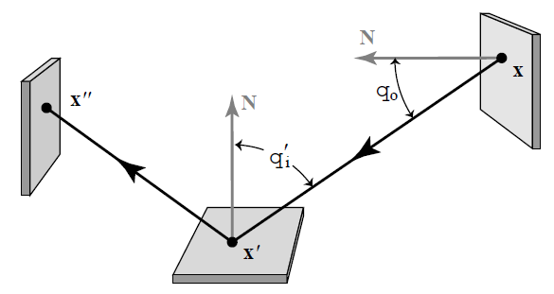
Three-point formulation of light transport
Let’s eliminate all directions and only talk about path vertices (i.e. points in the scene)
We introduce notation:

Slide 59
Rendering equation in the 3-pt formulation
Let’s use the above notation to rewrite the RE

Slide 60
Measurement equation in the 3-pt formulation
Visual importance emitted from x’ to x
(Notation: arrow = direction of the flow of light, not importance)
x’ ... on the sensor
x … on the scene surface

Slide 61
Derivation of the path integral: A sketch
Plug the Neumann expansion of the RE into the measurement equation, you get a sum of integrals.
The integrand of this sum is the path contribution function.

Slide 62
“Path integral” – A historical remark
This course [Veach and Guibas 1995], [Veach 1997]
Easily derived form the rendering equation [Veach 1997]
Feynman path integral formulation of quantum mechanics [Feynman and Hibbs 65]
Homogeneous materials [Tessendorf 89, 91, 92]
Rendering [Premože et al. 03, 04]
Notes:
The term “path integral formulation” has a different meaning for different people.
What I’ve presented in this course has been derived by Veach and Guibas by fairly straightforward manipulation of the Neumann series solution of the rendering equation.
More widely known is Feynman’s path integral formulation, used to solve problems in quantum mechanics. In this formulation the transport paths are general curves, so the path space that we considered here (polylines) is just a small sub-space (of measure zero) of the path space in Feynman’s formulation.
Tessendorf used Feynman’s path integral formulation to derive the solution of light transport in strongly forward scattering media.
This solution has been used for rendering by Premože and colleagues.

Slide 63
Bidirectional path tracing

Slide 64
Bidirectional path tracing
Bidirectional path sampling
Path tracing
Light tracing
Notes:
Bidirectional path tracing is based on combining many different path sampling techniques.
It uses the path sampling from a path tracer and a light tracer.
And it adds the bidirectional path sampling techniques, where a full path is built by connecting a sub-path from the camera and from the light source.

Slide 65
All possible bidirectional techniques
vertex on a light sub-path
vertex on en eye sub-path

path tracing





light tracing
Notes:
In fact, one single path can be sampled with the local sampling techniques in many different ways.
This slide schematically shows all the possible bidirectional techniques that we can obtain by starting a path either on a light source or on the camera for an example path of length 4.
The first two cases correspond to what a regular path tracer usually does (randomly hitting the light sources and explicit light source connections.)
The last two are complementary to the first two and therefore correspond to light tracing.
The techniques in between are the bidirectional techniques where a sub-path sampled from the camera is connected to a sub-path sampled from a light source. The different bidirectional techniques correspond to the different number of vertices at the camera and light sub-paths.
Each sampling technique importance samples a different subset of terms of the measurement contribution function.
However, in each of these techniques, there are some terms of the measurement contribution function that are not importance sampled.
The purely unidirectional techniques (top and bottom) do not importance sample the light emission and sensor sensitivity, respectively. Indeed, for example the technique at the top relies on randomly hitting a light source, without incorporating any information about the location of light sources in the scene.
All the bidirectional techniques, that is, those that involve connection of two sub-paths, are usually unable to importance sample the terms associated with the connection edge.

Slide 66
All possible bidirectional techniques
vertex on a light sub-path
vertex on en eye sub-path

path tracing

no single technique importance
samples all the terms

VPLs



light tracing
Notes:
So we have many different techniques, but none of them is able to importance sample all of the terms of the measurement contribution function.
But because each technique fails at importance sampling a different term of the contribution function, they have complementary strong points and weaknesses.
It is exactly for this reason that bidirectional path tracing is built around the idea of taking the best of each of the techniques by combining them together using Multiple Importance Sampling.

Slide 67
Bidirectional path tracing
Use all of the above sampling techniques
Combine using Multiple Importance Sampling
Generalizes the combined strategy for calculating direct illumination in a path tracer
PT: Different strategies for sampling a direction toward a light source
BPT: Different strategies for sampling entire light transport paths
Notes:
The main idea of bidirectional path tracing is to use all of the sampling techniques above and combine them using multiple importance sampling.

Slide 68
Naive BPT
Notes:
A basic implementation of BPT samples two independent sub-path, one from the light source and another form the camera.
After that, the end points of these sub-paths are connected to generate a full path.

Slide 69
MIS weight calculation
Notes:
Because the length of the camera and light sub-path is selected randomly, this procedure has a non-zero probability for generating this exact same path in many different ways, all shown in the boxes at the bottom.
To evaluate the MIS weight of the generated path, we need to calculate the PDF of all these alternative sampling techniques, and plug them into the MIS formula.
This is fairly straightforward with the PDF formulas given earlier.
That’s really all for BPT – the basic idea is very simple.

Slide 70
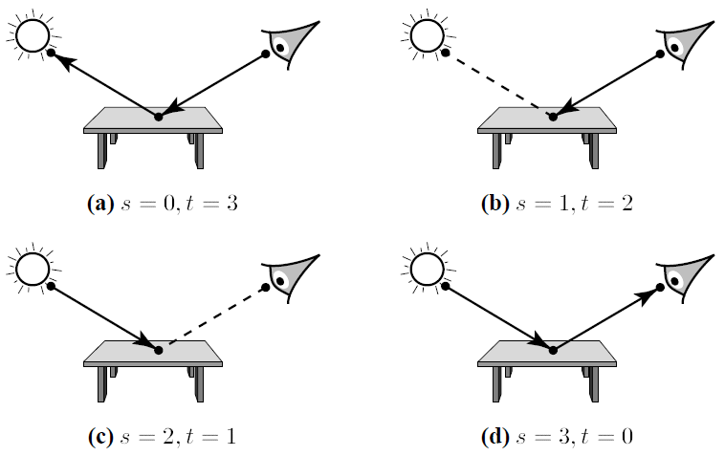
Sampling techniques in BPT
Example: Four techniques for k = 2
Image: Eric Veach

Slide 71
Sampling techniques in BPT
Sub-path with t vertices sampled from the camera
Sub-path with s vertices sampled from the light sources
Connection segment of length 1
Total path length : k = s + t – 1 (number of segments)
In BPT, there are k+2 way to generate a path of length k

Slide 72
Sampling techniques in BPT
Each path sampling technique has a different probability density p_{s,t}
Each techniques is efficient at sampling different kinds of lighting effects
All of them estimate the same integral

Slide 73
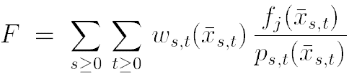
Combination of path sampling techniques
Combined estimator (MIS)
MIS weights (e.g. the balance heuristic)

Slide 74
BPT implementation in practice
Notes:
To speed up the calculation, in practice each vertex from the first sub-path is connected to each vertex of the second sub-path.

Slide 75
BPT implementation in practice
Notes:
This generates a full family of paths, some of which are shown above.
Nonetheless, on a conceptual level, each of these paths is treated completely independently of all the other ones.
I really want to stress that this path reuse scheme is just an implementation detail. It does improve the efficiency thanks to the reuse of the sub-paths, but does not contribute to the robustness of BPT in any way.

Slide 76
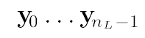
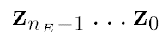
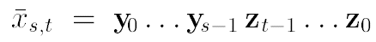
BPT implementation in practice
Sample a sub-path of a random length starting from light sources
Sample a sub-path of random length starting from the camera
Connect each prefix of a sub-path from light with each suffix of a sub-path from the camera

Slide 77
Results
Images: Eric Veach
BPT, 25 samples per pixel
PT, 56 samples per pixel

Slide 78
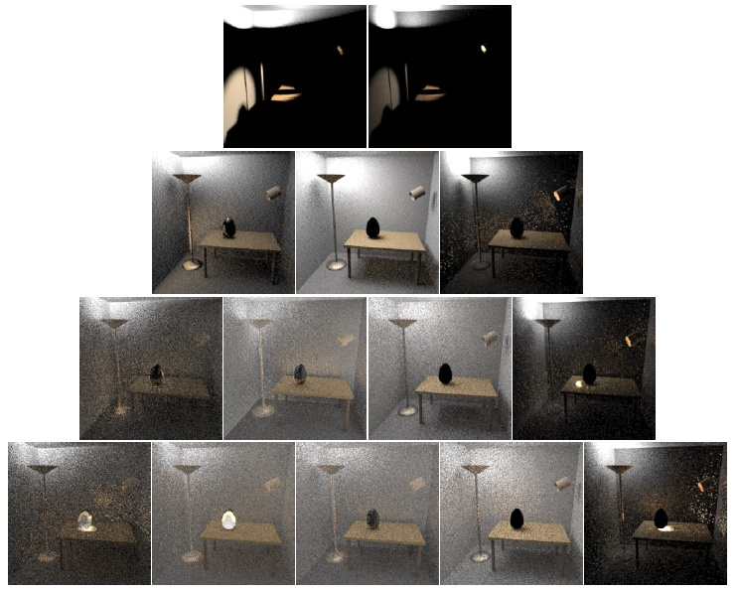
k = 2
(2x)
k = 3 (4x)
k = 4
(8x)
k = 5
(16x)
s = 1
s = 2 ...
t = 2
t = 1
s / t = number of vertices on the sub-path from light / camera

Slide 79
Algorithm comparison again
© F. Suykens
Path tracing
Light tracing
Bidirectional path tracing

Slide 80
Limitations of local path sampling

Slide 81
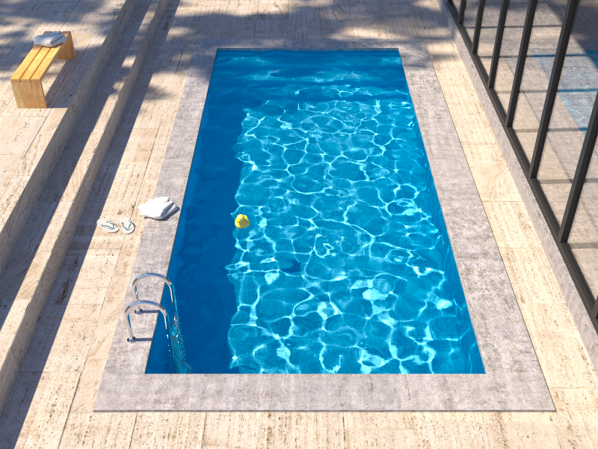
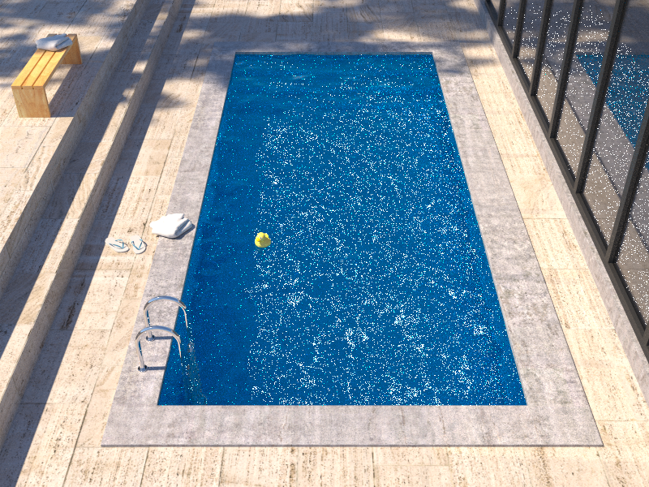
Insufficient path sampling techniques
Reference solution
Bidirectional path tracing
Notes:
Bidirectional path tracing is much more robust than path tracing, light tracing, or VPL rendering.
However, it still struggles with some lighting effects, the most common of which are the specular-diffuse-specular (SDS) paths corresponding to reflected caustics – in this example the caustics at the pool bottom.

Slide 82
Insufficient path sampling techniques
Some paths sampled with zero (or very small) probability
specular – S
diffuse – D
Notes:
As usual, the culprit is inappropriate path sampling. The problem is that none of the path sampling techniques used in bidirectional path tracing is efficient at sampling the SDS effects, so their combination cannot sample those effects either.
To see this, consider the example on the slide. We have a pool (diffuse – D) filler with water (specular – S), a pinhole camera, and a small light source.
No path connections are possible because of the two specular vertices. Unidirectional sampling from the light source is not possible either because of the pinhole camera.
So we are left with one single (unidirectional) path sampling technique that starts from the camera, and hopes to randomly strike the light source. It is not hard to see that the smaller the source, the lower the probability of hitting the source and the higher the estimator variance.
In the limit, for point sources and pinhole camera, the SDS effects cannot be sampled by local path sampling at all.

Slide 83
Alternatives to local path sampling
Global path sampling – Metropolis light transport
Initial proposal still relies on local sampling
Leave path integral framework
Density estimation – photon mapping
Unify path integral framework and density estimation
Vertex Connection & Merging
Notes:
To sample SDS effects efficiently, we need to look for alternatives to local path sampling.
One such alternative are global path sampling techniques that sample a path as a whole, as opposed to incrementally vertex-by-vertex. This is for example the case of Metropolis light transport and other Markov Chain Monte Carlo techniques. The issue is that the Markov chain of path mutations needs to be initialized with some path, and this path has to be generated somehow – and we’re back to local path sampling.
We could also look for an entirely different solution of light transport, outside the classic path integral formulation. A popular example of this approach is photon mapping, which relies on density estimation.
However, photon mapping is fairly inefficient at some lighting effects (such as diffuse inter-reflections) which are very efficiently handled by the path sampling techniques in BPT.
So the vertex connection and merging algorithm reformulates photon mapping in the path integral framework, which enables a robust combination of photon mapping and BPT using Multiple Importance Sampling.

Slide 84
Our work: Vertex Connection and Merging

Slide 85
Robust photon mapping
Where exactly on the camera sub-path should we look-up the photons?
Commonly solved via a heuristic:
Diffuse surface … make the look-up right away
Specular surface … continue tracing and make the look-up later
But what exactly should be classified as “diffuse” and “specular”?
We need a more universal and robust solution
Solution:
Bidirectional photon mapping [Vorba 2011]
Vertex Connection and Merging [Georgiev et al., 2012]

Slide 86
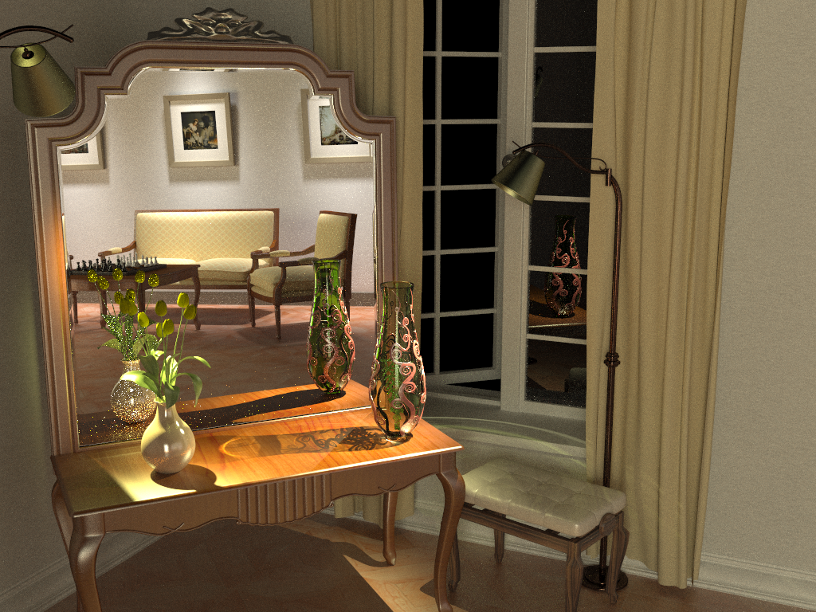
Bidirectional path tracing (30 min)
Notes:
This example, we saw that bidrectional path tracing and photon mapping are pretty much complementary in terms of their strengths and weaknesses. BPT cannot do reflected caustics, but is really good at the overall diffuse illumination.

Slide 87
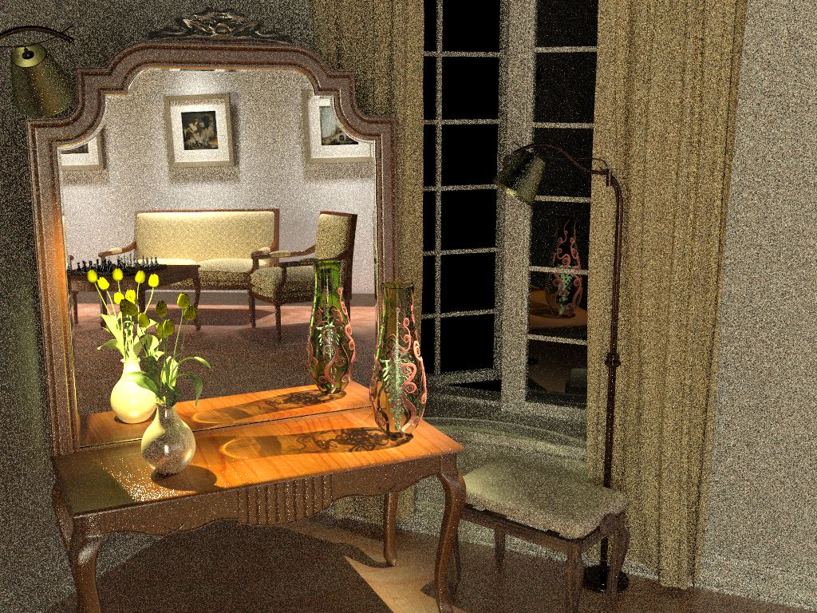
Photon mapping (Density estimation) (30 min)
Notes:
And vice versa for photon mapping.

Slide 88
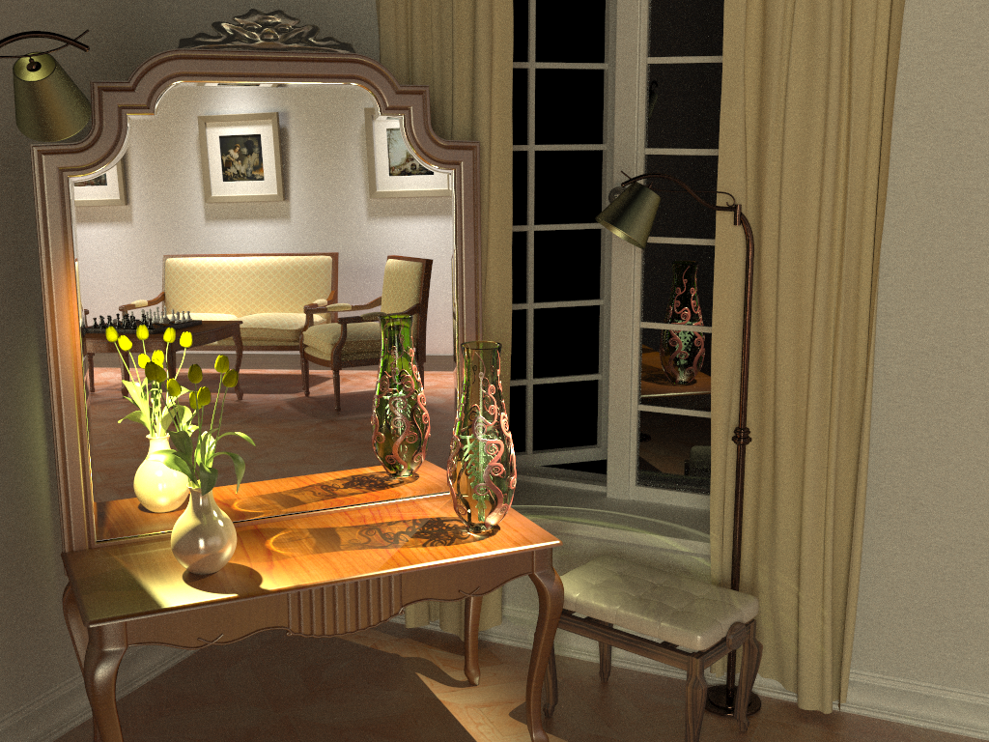
Vertex connection and merging (30 min)
Notes:
By using multiple importance sampling to combine estimators from bidirectional path tracing and photon mapping, the algorithm I will talk about today automatically finds a good mixture of techniques for each individual light transport path, and produces a clean image in the same amount of time.

Slide 89
Overview
Problem: different mathematical frameworks
BPT: Monte Carlo estimator of a path integral
PM: Density estimation
Key contribution: Reformulate photon mapping in Veach’s path integral framework
Formalize as path sampling technique
Derive path probability density
Combination of BPT and PM into a robust algorithm
Notes:
However, even though both methods have been published more than 15 years ago, neither a rigorous analysis of their relative performance nor an efficient combination had been shown until very recently. The reason for this is that BPT and PM have originally been defined in different theoretical frameworks – BPT as a standard Monte Carlo estimator to the path integral, and PM as an outgoing radiance estimator based on photon density estimation.
The first step toward combining these two methods is to put them in the same mathematical framework. We choose Veach’s path integral formulation of light transport, as it has a number of good properties and also because BPT is already naturally defined in this framework.
We need two key ingredients: (1) express PM as a sampling technique that constructs light transport paths that connect the light sources to the camera, and (2) derive the probability densities for paths sampled with this technique. This will give us a basis for reasoning about the relative efficiency of BPT and PM. And more importantly, it will lay the ground for combining their corresponding estimators via multiple importance sampling.

Slide 90
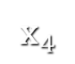
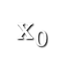
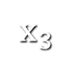
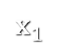
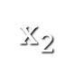
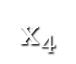






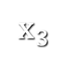
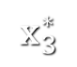


Sampling techniques
Light vertex
Camera vertex
Unidirectional
2 ways
Vertex connection
4 ways
Vertex merging
5 ways
Total
11 ways
Notes:
Now that we have formulated the vertex merging path sampling technique, we can put it side by side with the already available techniques in BPT. There are two ways to sample a length-4 path unidirectionally, and four ways to sample it via vertex connection. Vertex merging adds five new ways to sample the path, corresponding to merging at the five individual path vertices. In practice, we can avoid merging at the light source and the camera, as directly evaluating emission and sensitivity is usually cheap.
But with so many ways to sample the same light transport path, a question naturally arises in the mind of the curious: which technique is the most efficient for what types of paths?

Slide 91
Combining path sampling techniques for volumetric light transport
In the following we apply MIS to combine full path sampling techniques for calculating light transport in participating media.
The results come from the SIGGRAPH 2014: Křivánek et al. Unifying points, beams and paths in volumetric light transport simulation.

Slide 92
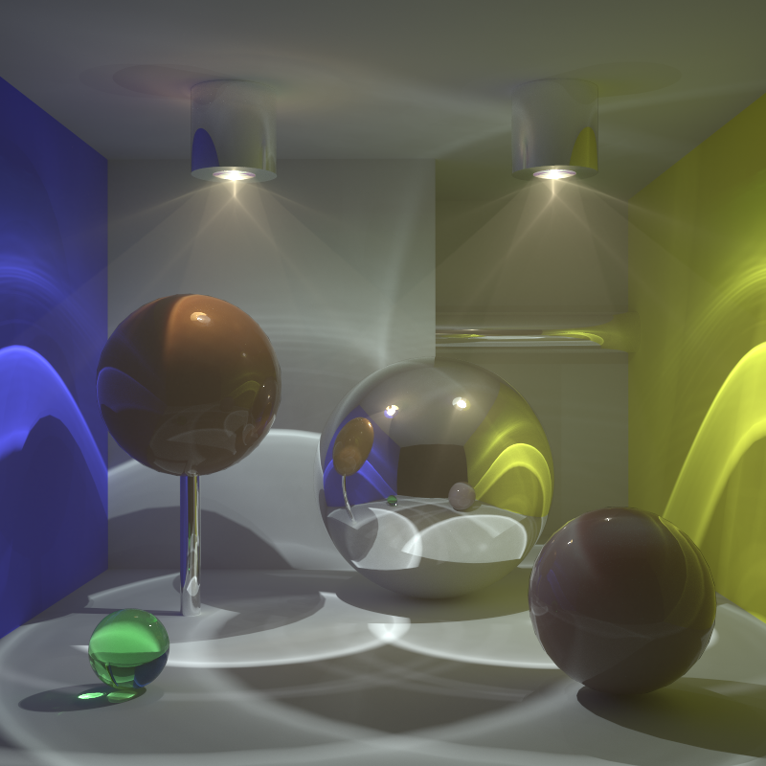
Full transport
rare, fwd-scattering fog
back-scattering
high albedo
back-scattering
Notes:
We have set up this test scene which is filled with rare, forward scattering fog.
There are two spheres filled with a dense back-scattering medium.
And the scene is illuminated almost entirely by caustic lighting.

Slide 93
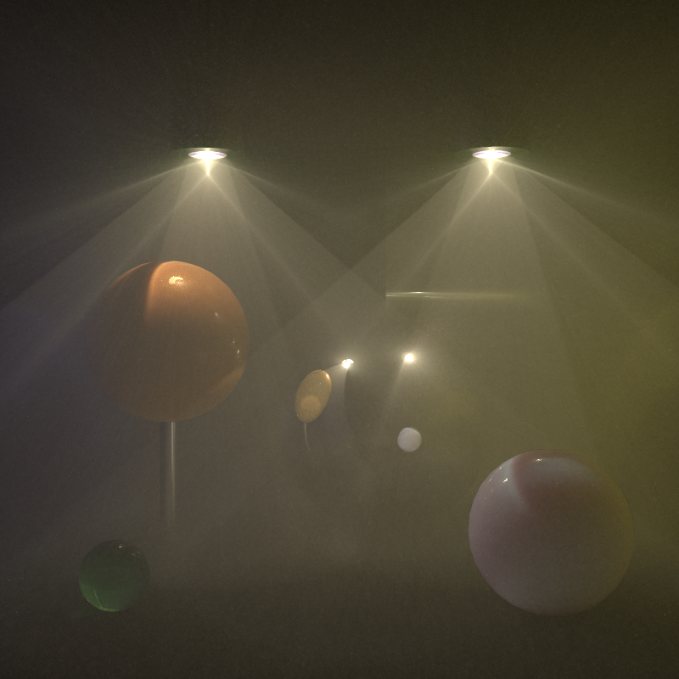
Medium transport only
Notes:
For the algorithm comparison, we again consider only transport in media.

Slide 94
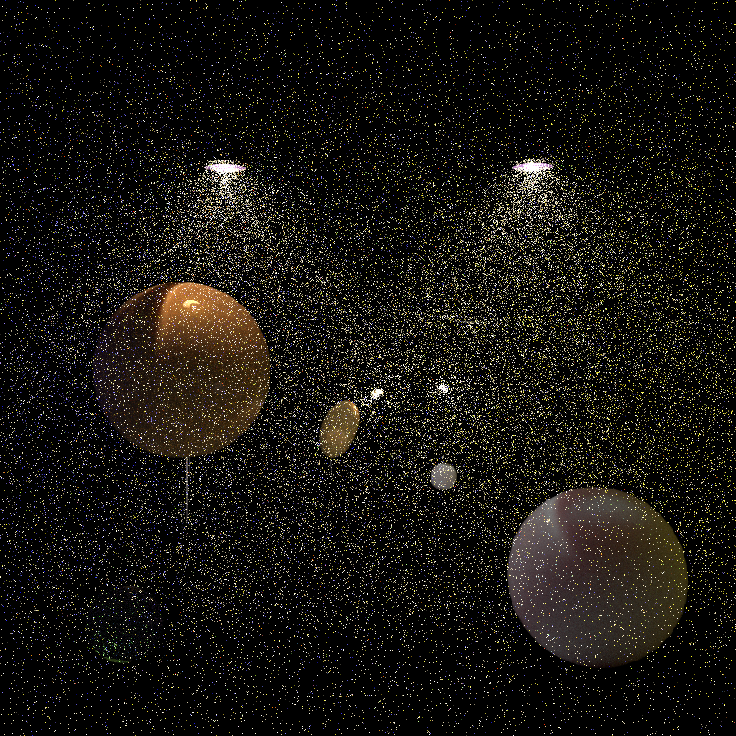

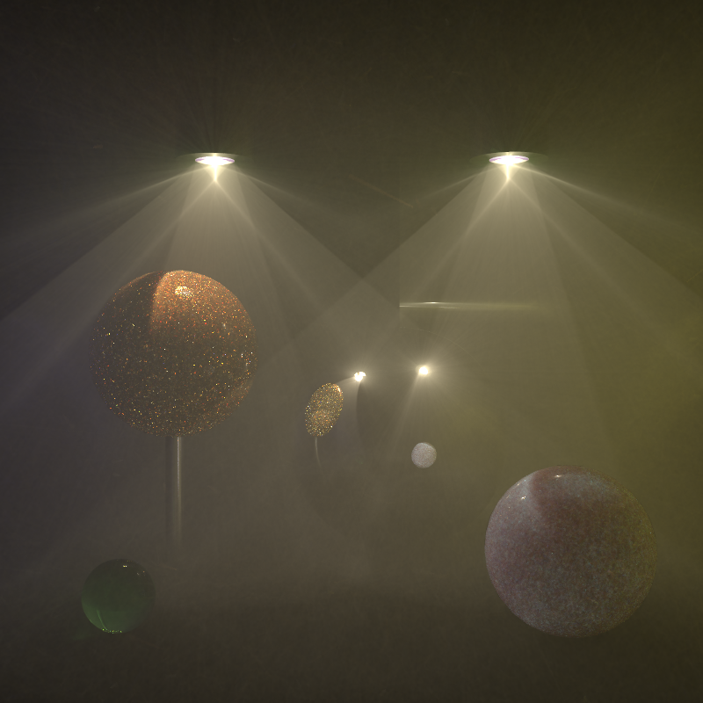
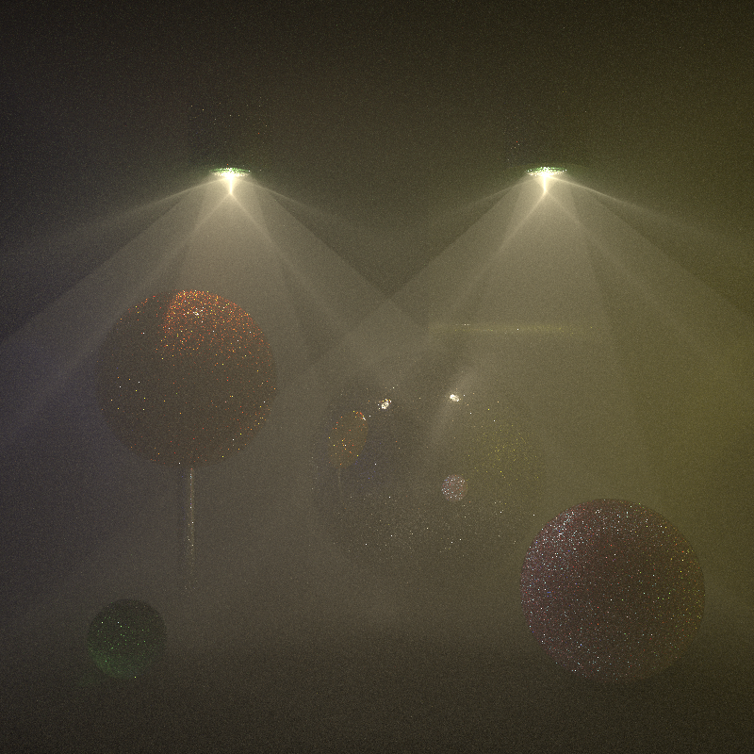
Previous work comparison, 1 hr
Point-Point 3D (≈vol. ph. map.)
Point-Beam 2D (=BRE)
Beam-Beam 1D (=photon beams)
Bidirectional PT
Notes:
And here’s how the previous work does.
The point-point estimator, which is equivalent to volumetric photon mapping without ray marching, does a pretty good job at rendering the dense spheres but cannot handle the sparser fog.
The point-beam estimator, or the beam radiance estimate, does a much better job at rendering the fog, though it still fairly noisy as you can see in the inset.
The beam-beam estimator, or photon beams, provides excellent results for the fog, bug the spheres suffer from some nasty noisy artifacts.
Bidir handles the fog quite well, though not as well as the photon beams. It produces bad artifacts in the dense spheres because much of the illumination there is essentially a reflected caustic.

Slide 95
UPBP (our algorithm) 1 hour
Notes:
Our algorithm is able to take the best from the individual techniques to produce a much cleaner image.

Slide 96
Previous work comparison, 1 hr
Point-Point 3D
Point-Beam 2D
Beam-Beam 1D
Bidirectional PT
Notes:
Let’s go back to the results of the previous work and ….

Slide 97
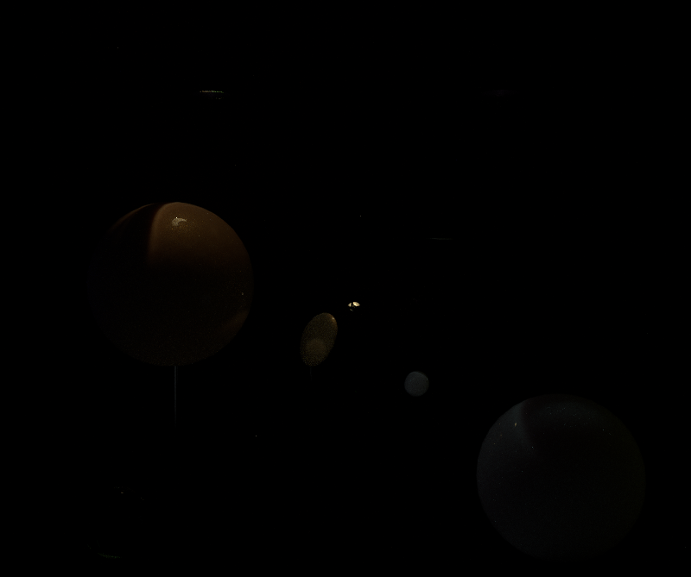
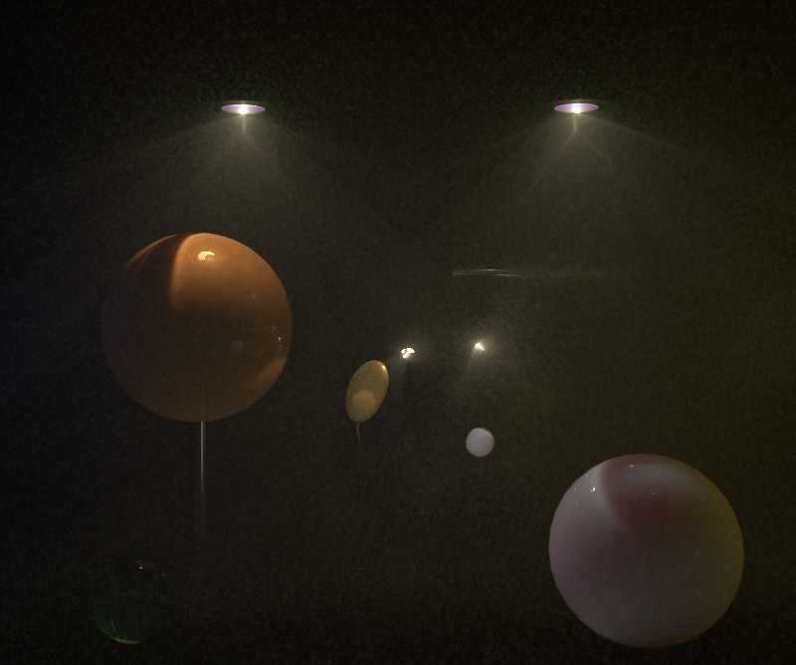
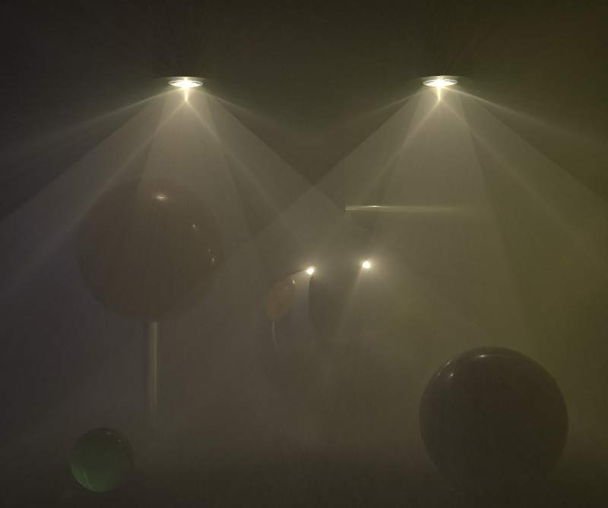
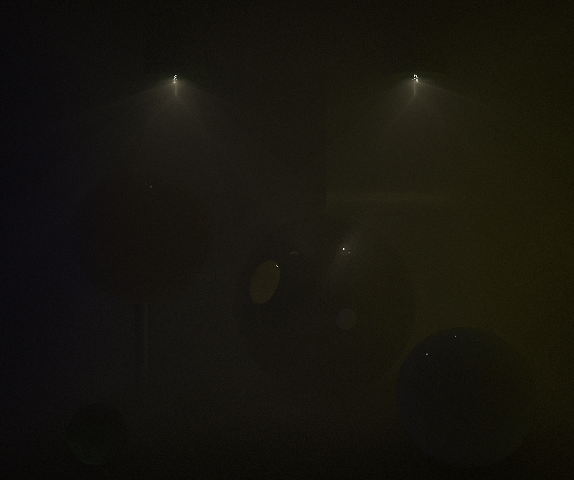
Point-Point 3D
Point-Beam 2D
Weighted contributions
Beam-Beam 1D
Bidirectional PT
Notes:
… and let’s start replacing it by the weighted contribution of the individual estimators to our combined result.
PP, PB, BB, BPT.
We see that most of the image is made up from the contributions from the point-beam and beam-beam estimators, where the point-beam takes care of rendering the dense, back-scattering spheres, and the beam-beam estimator renders the rarer fog.
Bidirectional path tracing contributes mostly the surface-to-medium transport, which is visible as the blue tint of the right sphere.

Slide 98
Literature
E. Veach: Robust Monte Carlo methods for light transport simulation, PhD thesis, Stanford University, 1997, pp. 219-230, 297-317 http://www.graphics.stanford.edu/papers/veach_thesis/

